Slide 1

CMSC 628 – Spring 2019 Introduction to Mobile Networks
Dr. Eyuphan Bulut
CMSC 628- Mobile Networks

Slide 2

Mobile Communication World
Proliferation of mobile computing and communication devices starting late 90s
Cell phones, laptops
Handheld digital devices
Personal Digital Assistants (PDA)
Wearable computers
WiFi hot spots replaced wired access networks

Slide 3
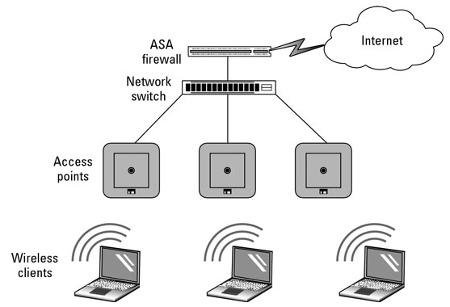
Infrastructure Networks
Devices on the network all communicate through an access point: a device that allows wireless devices to connect to a wired network using Wi-Fi
Challenges:
it takes time and potentially high cost to set up the necessary infrastructure everywhere.
Not works for dynamic environments
E.g. rural or disaster areas

Slide 4
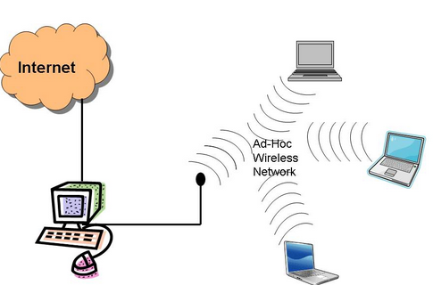
Infrastructure-Less Networks
Decentralized type of wireless network
Self organizing or Infrastructure-less
It does not rely on
preexisting infrastructure such as routers in wired networks
access points in wireless networks
The wireless network nodes (e.g., the users’ mobile devices) communicate with each other to perform data transfer
Nearby users can communicate directly by exploiting the wireless technologies of their devices in ad hoc mode

Slide 5
Mobile (Ad hoc) Networks (MANET)
Ad-hoc means ‘for this purpose’
used to describe something that has been formed or used for a special and immediate purpose, without previous planning.
Self organizing networks (SON)
Wireless
transmission
range

Slide 6
Mobile Ad hoc Network (MANET)
Each device is free to move independently in any direction, and will therefore change its links to other devices frequently
Hence, it has a dynamic topology
The primary challenge in building a MANET is equipping each device to continuously maintain the information required to properly route traffic

Slide 7
MANET forms
Single-hop
Simplest form
Direct connectivity
Multi-hop
MANETs often refer to this form of connectivity

Slide 8
Challenges
Infrastructure-less design adds difficulty in fault detection and management
Dynamic topology results in route changes and packet loss
Scalability is still unsolved, challenges include addressing, routing, configuration management, interoperability, etc.
Varied link/node capabilities cause variable processing capabilities
Energy constraints limit processing power; ad-hoc networks rely on each node being a “router”

Slide 9
Applications of MANETs
Advantages: low-cost, flexibility
Ease & Speed of deployment
Decreased dependence on infrastructure
Applications
Military environments
soldiers, tanks, planes
Civilian environments
vehicle networks
conferences / stadiums
outside activities
Emergency operations and disaster scenarios
search-and-rescue / policing and fire fighting

Slide 10
MANET History
In 2000-2005, MANET was one of the most innovative and challenging areas of wireless networking
Numerous research efforts
Today, the promise of ad hoc networking never fully realized, and that MANET solutions are not used in people’s life
A few practical deployments
FireChat, Serval Project
Reasons:
Lack of real approaches/objectives in research
Only theoretical parts of interesting research questions studied
Mostly simulation based evaluation without real experiments

Slide 11
MANET Research
Focus:
Mostly focused on general purpose pure MANET
No specific application
Aimed to extend Internet services to non-infrastructure areas
A complete redesign of network architecture and protocols
Efficient communication algorithms
Standardization efforts through IETF MANET Working Group
IETF = Internet Engineering Task Force

Slide 12
IETF MANET Working Group
https://datatracker.ietf.org/wg/manet/about/
“The purpose of the MANET working group is to standardize IP routing protocol functionality suitable for wireless routing applications within both static and dynamic topologies with increased dynamics due to node motion or other factors.”
“Approaches are intended to be relatively lightweight in nature, suitable for multiple hardware and wireless environments, and address scenarios where MANETs are deployed at the edges of an IP infrastructure."

Slide 13
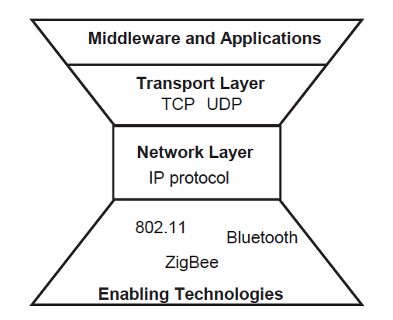
MANET Layers
Research did not focus on here much
Modified TCP extensions
Routing, forwarding
(most research here)
MANET layered stack
+ Cross-layer research issues

Slide 14
MANET Networking Layer
Routing: identifying the path between a sender and a receiver
Forwarding: The subsequent function of delivering the packets on the routing path
Legacy wired network based routing problems do not work due to dynamic and unpredictable nature of MANET topology
MANET routing protocols have the following common features. They aim to
discover a path from source to destination
maintain that path (e.g., if an intermediate node moves and breaks the path)
define mechanisms to exchange routing information

Slide 15
MANET Casting
Routing protocols can be defined based on different casting approaches:
Unicast
Broadcast
Multicast
Geocast
Main stream routing algorithms use unicast

Slide 16
MANET Routing Challenges
Routing overhead must be kept minimal
Wireless → low bandwidth
Mobile → low power
Minimize # of routing control messages
Minimize routing state at each node
Nodes must determine how to forward packets
Source routing: Routing decision is made at the sender
Hop-by-hop routing: Routing decision is made at each intermediate node
Difficult to achieve good performance
Routes change over time due to node mobility
Best to avoid long delays when first sending packets
Best to reduce overhead of route discovery and maintenance
Want to involve as many nodes as possible – to find better paths and reduce likelihood of partitions

Slide 17
MANET Routing Protocols
Others: Energy-aware, Cluster-based
Ad-Hoc Routing Protocol
Proactive Routing Protocol
Reactive Routing Protocol
Hybrid Routing Protocol
Hierarchical Protocol
Table-driven
Periodic distribution of routing tables among nodes
On-demand
Finds a route flooding Route Request (RREQ) packets
Combines the power of proactive and reactive routing
The choice of proactive and of reactive routing depends on the hierarchic level in which a node resides

Slide 18
Cross-Layer MANET Research
Some issues are not specific to a single layer:
Energy efficiency
Local and global strategies
Should consider both individual node energy and its impacts to the network
Always sleeping node without contributing to routing is not a good one
Topology control (via sleep scheduling, controlling the transmission power) without compromising coverage is a good one
Security
Malicious nodes can disrupt the proper functioning of routing (e.g., false routing tables)
Cooperation
Incentives for collaboration, to avoid selfishness
Virtual currency (paid for transmission, reward when forwarding others)

Slide 19
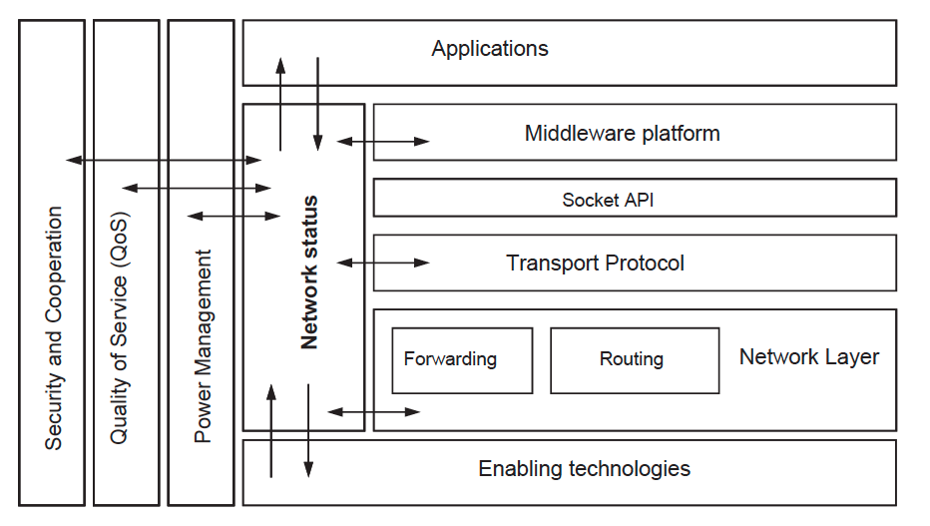
Cross Layer Architecture
Interlayer Communications
Additional communication channels between different layers
Interlayer Tuning
Joint optimization of each independent layer
Interlayer Design
Joint design of two (or more) layers.
Unlayered Design
shared memory
MobileMAN* architecture
*Borgia et. al.,MobileMAN: Design, integration, and experimentation of cross-layer mobile multihop ad hoc networks, IEEE Communications Magazine, 2006.

Slide 20
Evolution of MANET
Why the MANET paradigm did not have a major impact? What are the lessons learned?
Originally it was military research driven and could not make shift to civilian applications
Limited off-the-shelf wireless network technologies
Academia focused on interesting problems
Scarce exploitation and low interest among the users
Limited simulations and less credibility due to lack of implementation, integration and experimentation except a few (MobileMAN, Uppsala APE testbed, Darmouth College testbed)

Slide 21
From MANET to…
What are the new technologies emerged from MANET?
Mesh networks (integrated to infrastructure)
Opportunistic networks
Mobility as opportunity not a problem
Application focused
Wireless Sensor Networks (IoT Networks)
Vehicular Networks

Slide 22
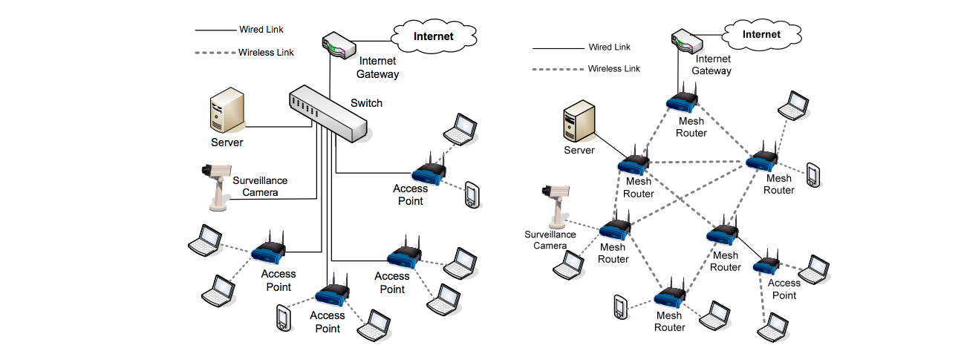
Mesh Networks
Aims to reduce the MANET complexities with integration of fixed networks
Low-cost extension of Internet with a few hop wireless links
Research has focused on all of implementation, integration and experiments on real networks with real users
Traditional WLAN
Mesh Network

Slide 23
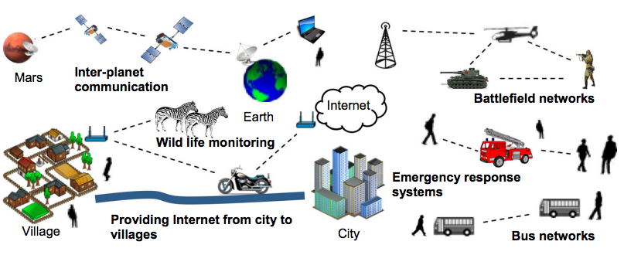
Opportunistic Networks
Delay tolerant networks (DTN), Intermittently Connected Networks
Characteristics:
No stable end-to-end path
Store-carry-and-forward paradigm for routing
Mobility not a problem but opportunity
Challenges:
Online decision making
Mobility understanding and modeling (e.g., inter-contact distribution)

Slide 24
Vehicular Ad Hoc Networks (VANETs)
Motivated by Intelligent Transportation System (ITS) goals
Reducing traffic congestions, road accidents..
Peculiar features of vehicular field
Road structure, high speeds etc.
New communication protocols: WAVE, DSRC
Inter-vehicle communication
Vehicle-to-roadside communication
Inter-roadside communication

Slide 25



Wireless Sensor Networks (WSN)
Sensor and actuator networks (Cyber and physical components)
Data collection at sink, stable & mobile sensors, message ferries/robots
Extensive research done on:
Topology control, energy saving, clock synch, coverage, connectivity, routing, MAC protocols
Limited unstudied topics:
Security/trust, Quality of service, realistic simulations, underwater sensor networks
New extensions: Human-centric (mobile) sensing/computing, participatory sensing
Env. monitoring agent
Fire detection agent
Fire tracking agent

Slide 26

WSN vs. IoT
WSN: a set of sensors that send their data to a sink, not necessarily connected to Internet
IoT: a set of (sensor) nodes that are connected to Internet (and cloud for analytics) either directly or via a gateway
Sensor node
Sink
Cellular
Analytics
(Sensor) node
Gateway

Slide 27
What’s next?
Next class: Enabling Technologies for Mobile Networks
MANET:
Medium Access Control (MAC)
Routing Protocols
Opportunistic networks
Routing algorithms, Mobility modeling, Analysis
Wireless Sensor Networks (IoT Networks)
Vehicular Networks

